Slide 1

Approximating solutions to
1st-order initial-value problems

Slide 2
Introduction
In this topic, we will
  Focus on 1st-order initial value problems (ivps)
  Observe how solving such solutions is equivalent to performing integration
  List the methods we will use to approximate solutions
  Observe that these solutions parallel algorithms we’ve already seen
  Show the meaning of the ordinary differential equation and the initial conditions visually

Slide 3
Initial-value problems
A first-order initial-value problem (ivp) is any such problem that can be written as:
  In calculus, techniques used in solving higher-order ivp, boundary-value problems, and partial differential equations often differ
  The techniques we will use to approximate solutions,
  however, can be generalized

Slide 4
Our approach
We could immediately jump to explaining the Dormand-Prince method…
  After all, this algorithm was specified in 1980
    An algorithm likely defined within the lifetime of your parents
Unfortunately, you would not understand the issues at hand
  Instead, we will build up with simpler solutions

Slide 5
Integration
It’s also useful to remember that this is integration:
Initial condition

Slide 6
Integration
Recall that in solving an initial-value problem,
we are integrating
  Consequently, the techniques are very similar
ivp algorithm
Integration algorithm
Euler’s method
Riemann sums
Heun’s method
Trapezoidal rule
4th-order Runge-Kutta method
Simpson’s rule
Adaptive Euler-Heun method
n/a
Adaptive Dormand-Prince method
n/a
Backward-Euler method
n/a

Slide 7
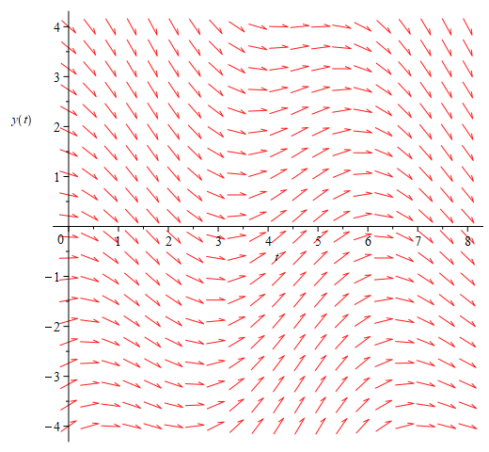
Visual interpretation
To understand how these techniques work, it is useful to understand what the ordinary differential equation means visually
  If , then the
  slope of y(t) for any t must
  equal the function in question

Slide 8
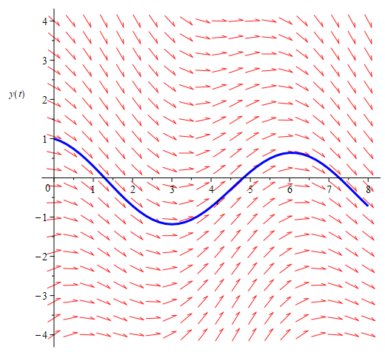
Visual interpretation
For example, if y(0) = 1, there is only one function that satisfies this condition and the differential equation

Slide 9
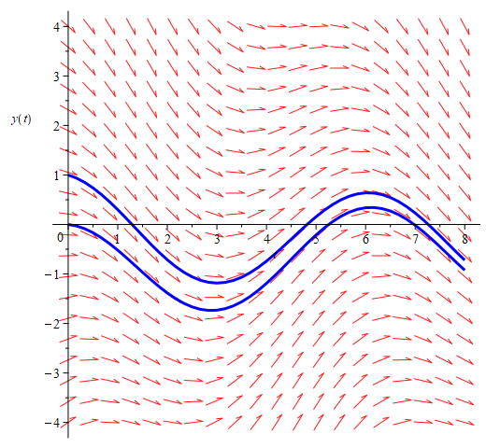
Visual interpretation
Similarly, if y(0) = 0, again, there is only one function that satisfies both this condition and the differential equation

Slide 10
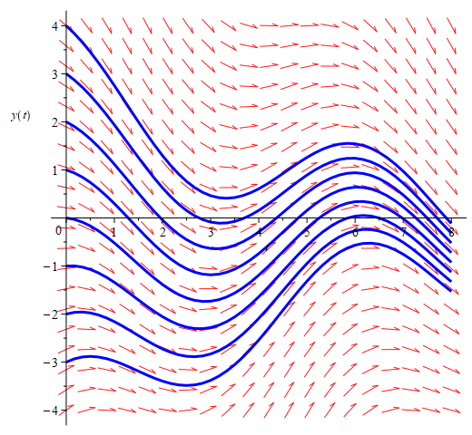
Visual interpretation
Indeed, any initial condition you specify results in a different
solution
  Our goal will be to
  approximate these solutions

Slide 11
Visual interpretation
Fortunately, we will use the differential equation:
  Suppose we have an initial
  condition y(0) = 1
  The slope here
  From Taylor series,
  you know that

Slide 12
Summary
Following this topic, you now
  Have a better understanding of an initial-value problem
  Are aware of how approximating such solutions are equivalent to performing integrations
  Understand how the differential equation gives the slope of solutions
  Understand how the initial condition specifies one specific solution

Slide 13
References
[1] https://en.wikipedia.org/wiki/Initial_value_problem

Slide 14
Acknowledgments
None so far.

Slide 15



Colophon
These slides were prepared using the Cambria typeface. Mathematical equations use Times New Roman, and source code is presented using Consolas. Mathematical equations are prepared in MathType by Design Science, Inc.
Examples may be formulated and checked using Maple by Maplesoft, Inc.
The photographs of flowers and a monarch butter appearing on the title slide and accenting the top of each other slide were taken at the Royal Botanical Gardens in October of 2017 by Douglas Wilhelm Harder. Please see
https://www.rbg.ca/
for more information.

Slide 16
Disclaimer
These slides are provided for the ece 204 Numerical methods course taught at the University of Waterloo. The material in it reflects the author’s best judgment in light of the information available to them at the time of preparation. Any reliance on these course slides by any party for any other purpose are the responsibility of such parties. The authors accept no responsibility for damages, if any, suffered by any party as a result of decisions made or actions based on these course slides for any other purpose than that for which it was intended.

